Slide 1
MVP
USING
To Get The Power of
MVC
For Your
Web Forms Project

Slide 2

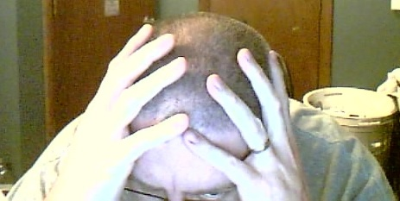


Project Lead Consultant
ABOUT ME
http://disruptivetheory.com
leebrandt@gmail.com
@leebrandt

Slide 3
My Motivation

Slide 4
<%@ LANGUAGE = VBScript %>

Slide 5
.aspx
.aspx.cs
aspx.designer.cs

Slide 6
http Request/Response
.aspx
.aspx.cs
aspx.designer.cs
(Passive View)
presenter.cs
Model

Slide 7
HTTP Response
HTTP Request
.aspx
mycontroller.cs
Data
(Supervising Controller)
Model

Slide 8
The
Difference
NOT
Pieces
is
In the
But in How They Communicate
_

Slide 10


